Slide 1
JAVA SEMINAR
12. Write a Java Message Service program to implement a simple client server application
using publisher/subscriber messaging domain.

Slide 2
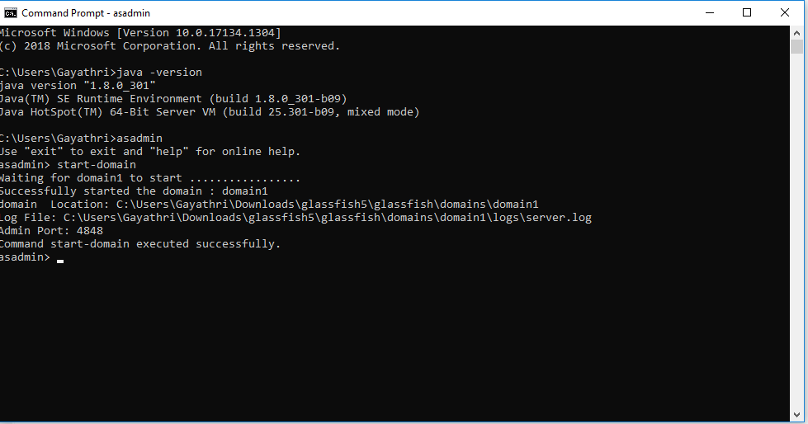
INSTALL glassfish application server and add it to netbeans IDE

Slide 3
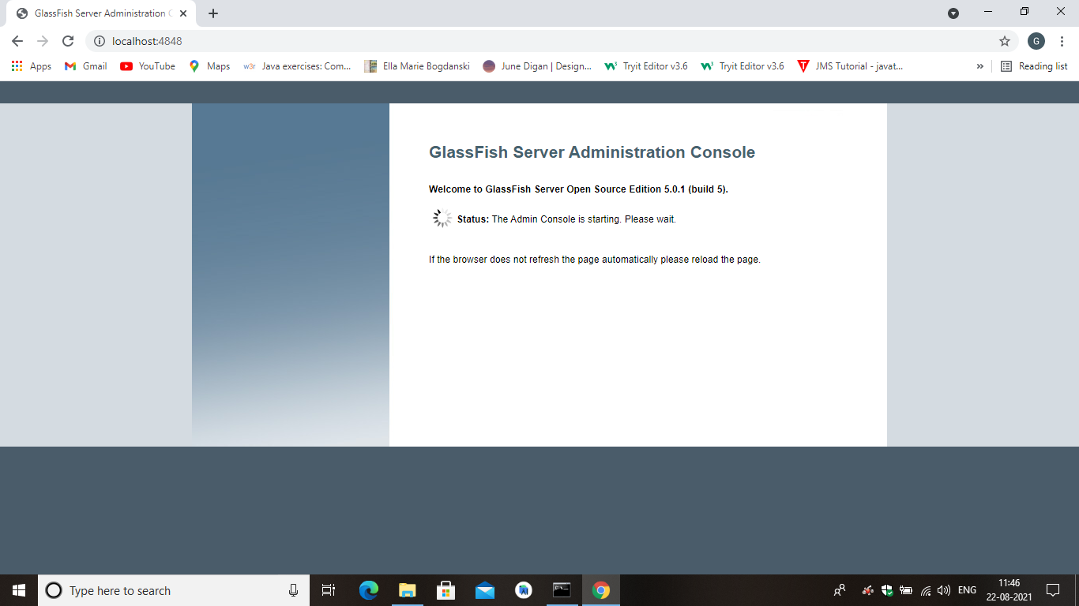
GLASSFISH server get started.

Slide 4
STEPS :
CREATE new project as enterprise application .
And create message driven class “MYLISTENER.JAVA”
Java class as “MYSENDER.JAVA”
One default HTML file “INDEX.HTML”.

Slide 5
STEPS:
Create two JNDI
Create connection factory named myTopicConnectionFactory.
Create destination resource named myTopic
After creating JNDI, create the mentioned files.

Slide 6
STEPS:
DEPLOY the project.
After successfull build.
In glassfish console , launch the project.

Slide 7
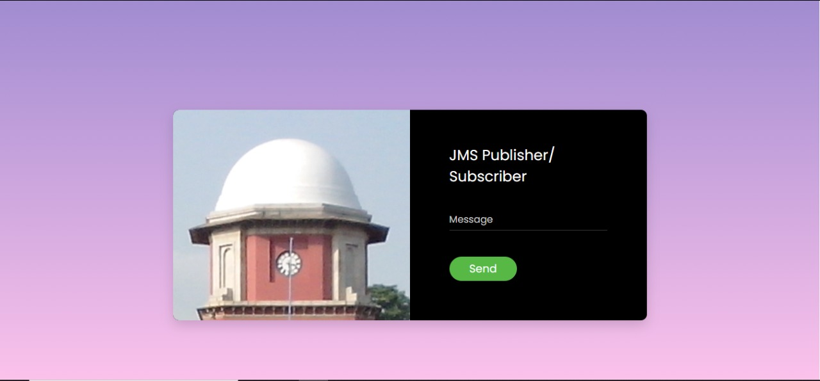
OUTPUT:

Slide 8

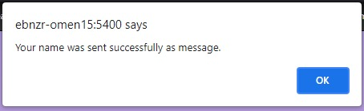
OUTPUT:

Slide 9
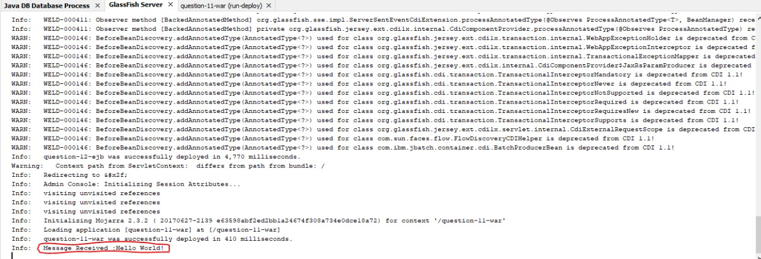
CONSOLE:

